Slide 1

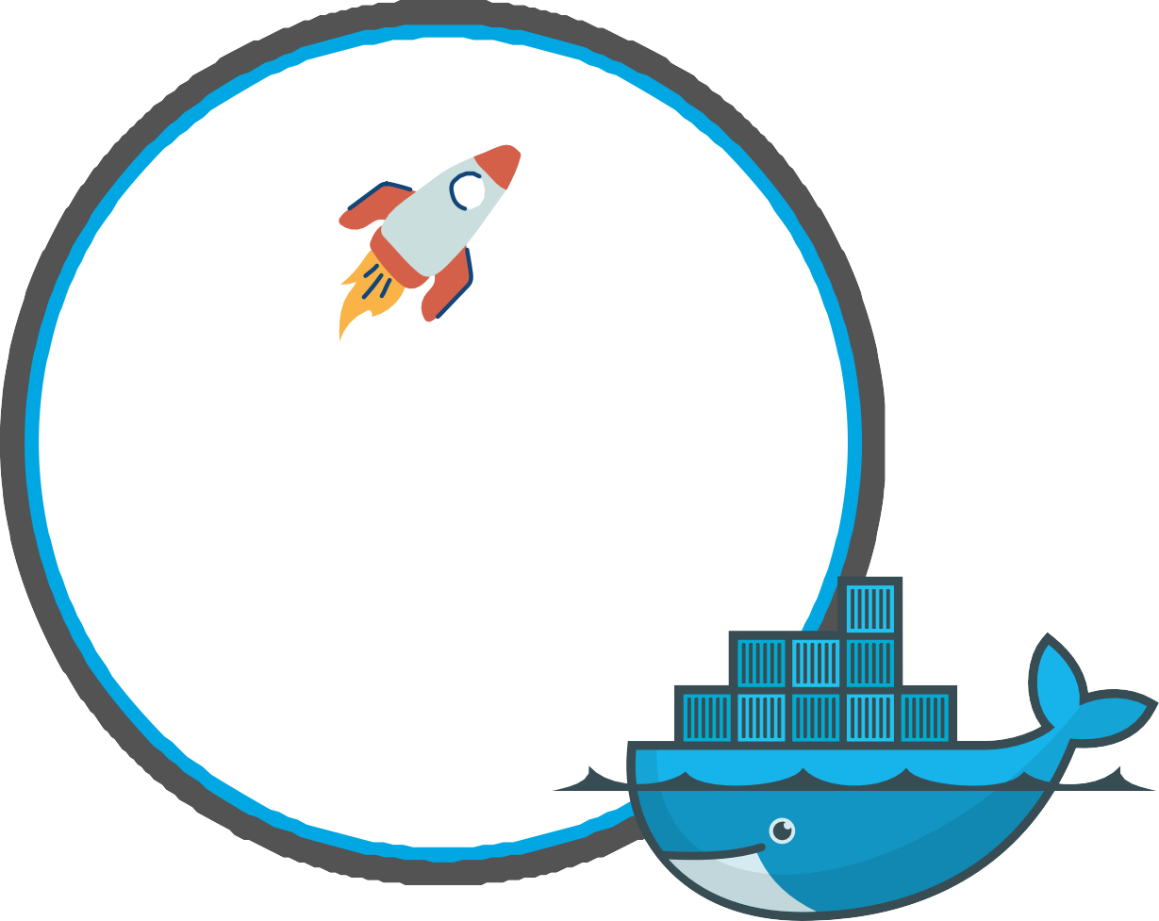


DEVOPS
BOOTCAMP
Containers with
Docker

Slide 2



Slide 3
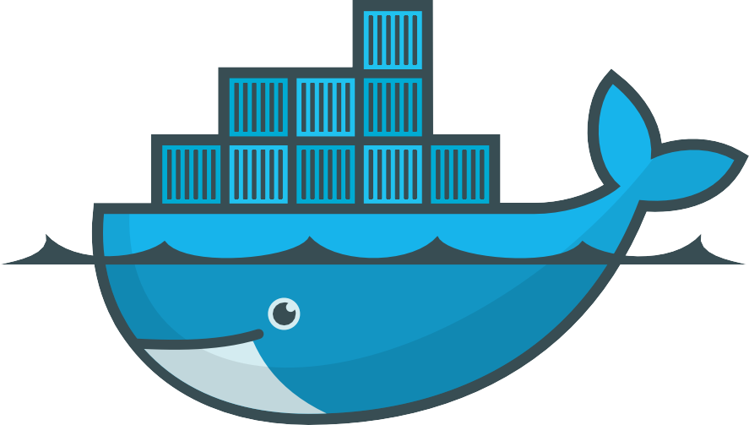
What is Docker?
Docker is an open source containerization platform
Enables developers to package applications into containers
Containers existed already before Docker Docker made containers popular
What is a container?
A way to package application with all the necessary dependencies and
configuration
Portable standardized artifact for development, shipment and deployment Makes development and deployment more efficient

Slide 4
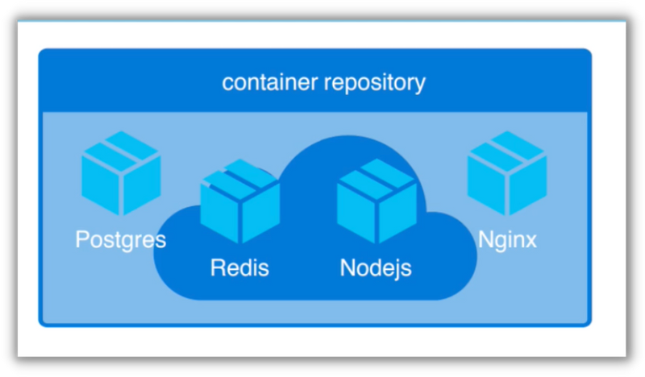

Where container artifacts are hosted
Hosted in container repositories
There are private and public repositories Public repository for Docker:

Slide 5
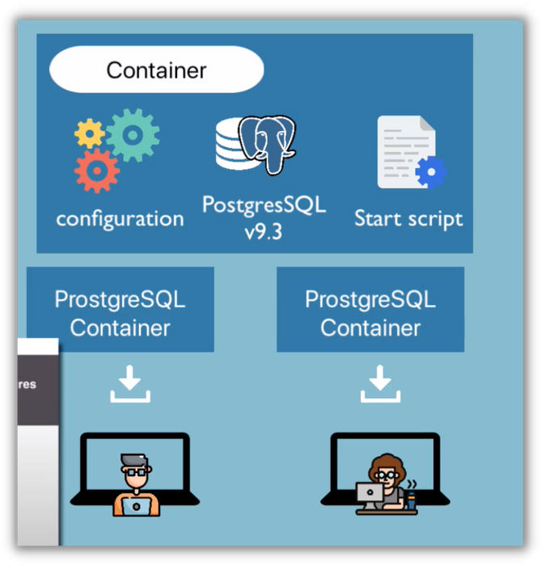



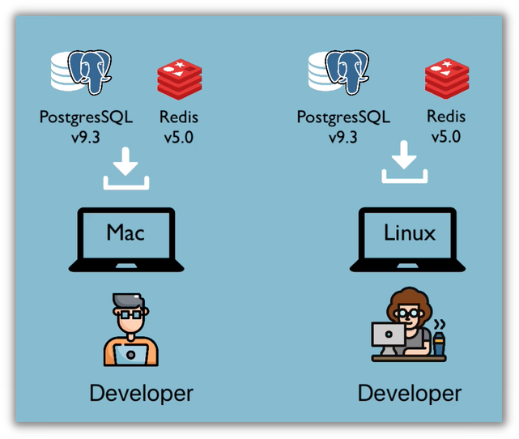
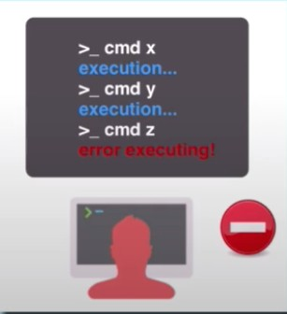
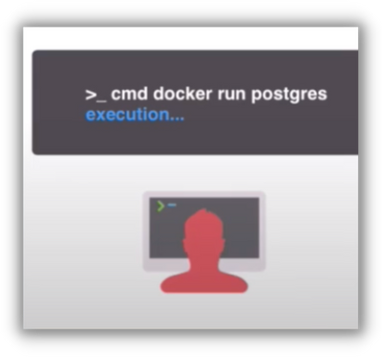
Application DEVELOPMENT before and after Docker
Before Containers
Installation process different on each OS environment
Many steps where something could go wrong
After Containers
Own isolated environment Packaged with all needed configurations
1 command to install the application
Easily run same application with 2 different versions

Slide 6
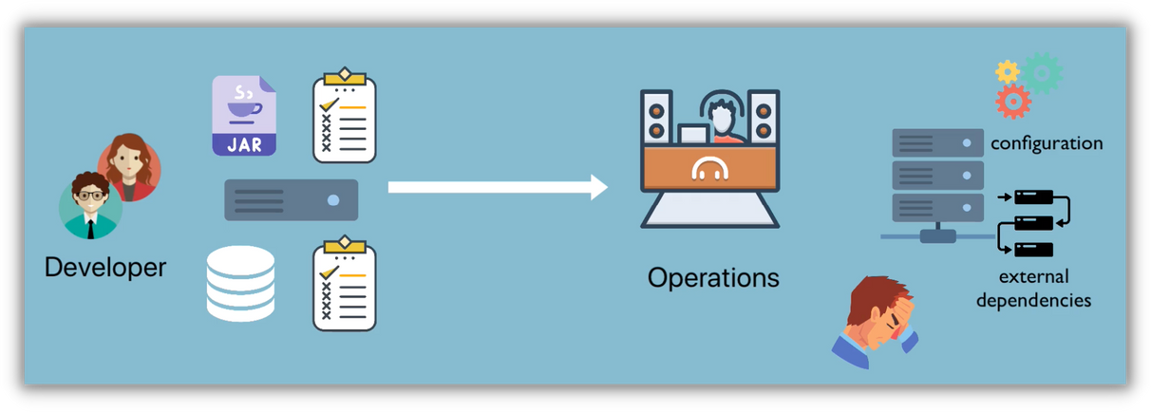
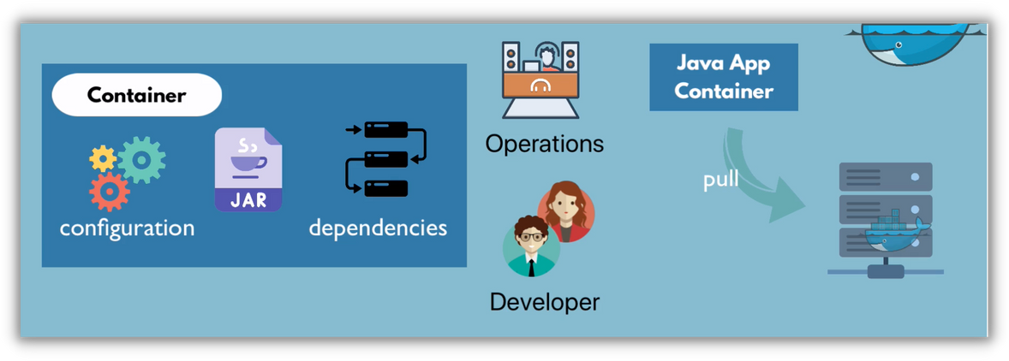

Application DEPLOYMENT before and after Docker
Before Containers
Configuration on the server needed Dependency version conflicts
Textual guide for deployment Misunderstanding
After Containers
Devs & Ops work together to package the application in a container
No environment configuration needed on server (except Container Runtime)

Slide 7



Docker = most popular container technology
Others:

Slide 8
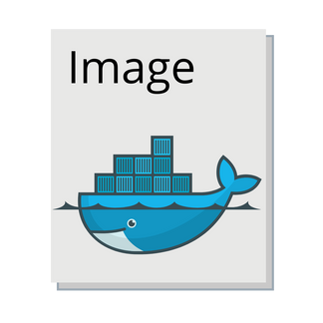
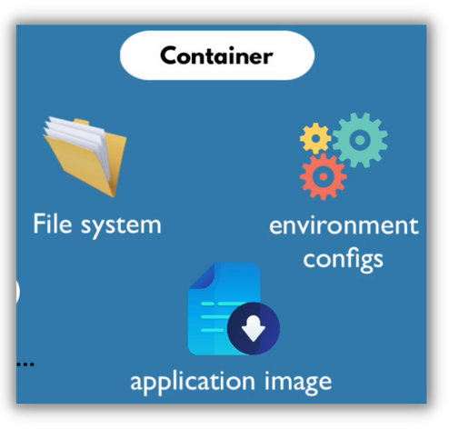
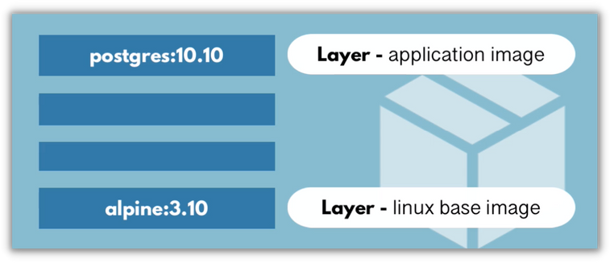
Docker Image vs Docker Container
Docker Image
Docker Container
Images become
Actually starts the application
Is a running environment defined in the image
The actual package (file)
Artifact that can be moved around Not in "running" state
Consists of several layers
Mostly Linux Base Image, application image on top
containers at runtime
Virtual file system
Port binding: talk to application running inside of container

Slide 9

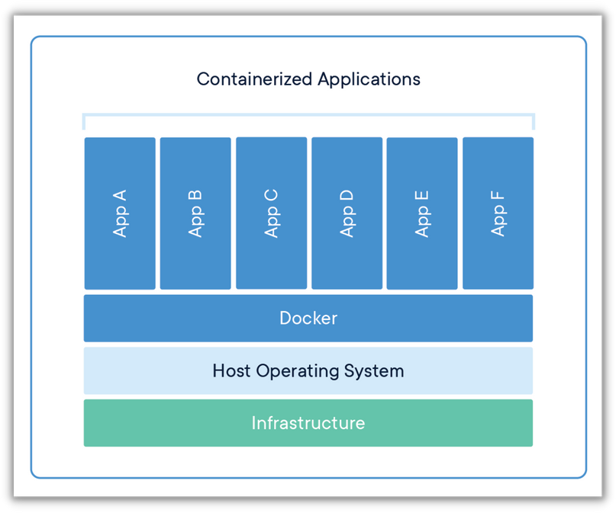
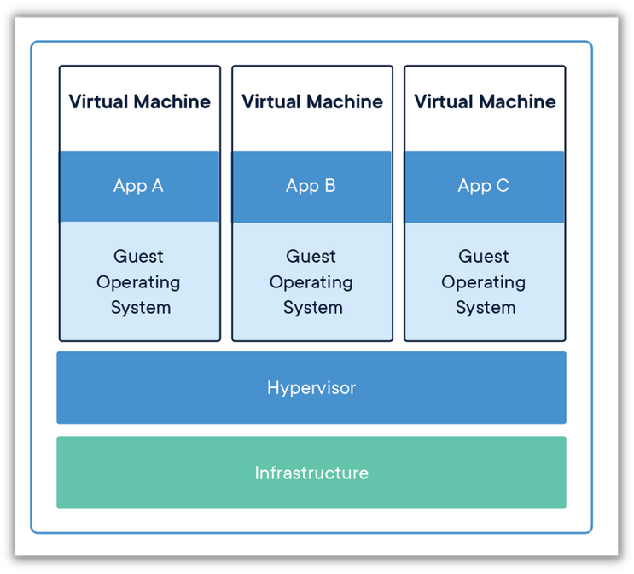
Containers
vs
Virtual Machines
Size: Docker Image much smaller
Speed: Docker containers start and run much faster
Compatibility: VM of any OS can run on any OS host
Abstraction at the app layer
Multiple containers share the OS kernel
Abstraction of physical hardware Each VM includes a full copy of an OS
Both are virtualization tools

Slide 10
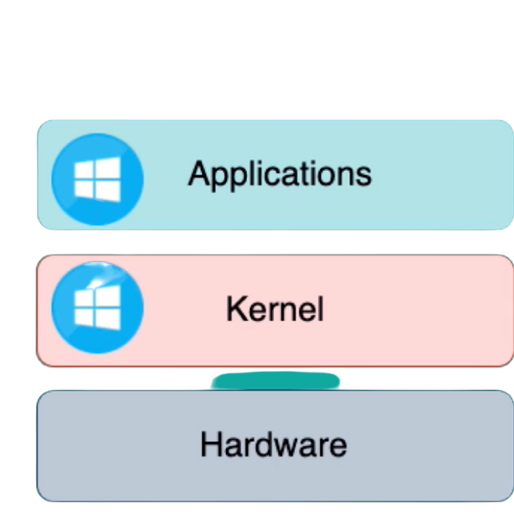
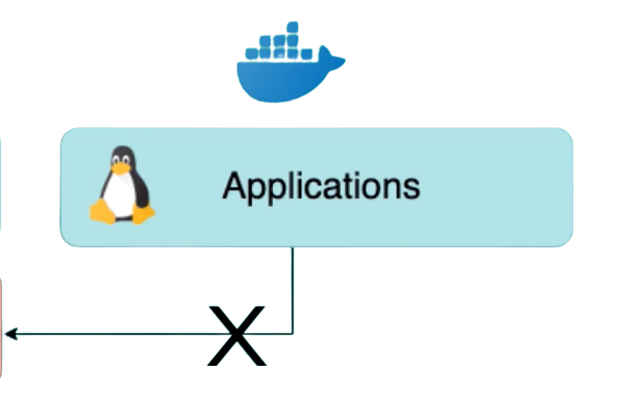
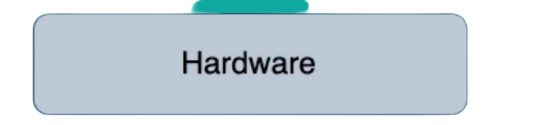
You can't run Linux container on Windows host, but for that there is
Docker Desktop for Windows and Mac

Slide 11
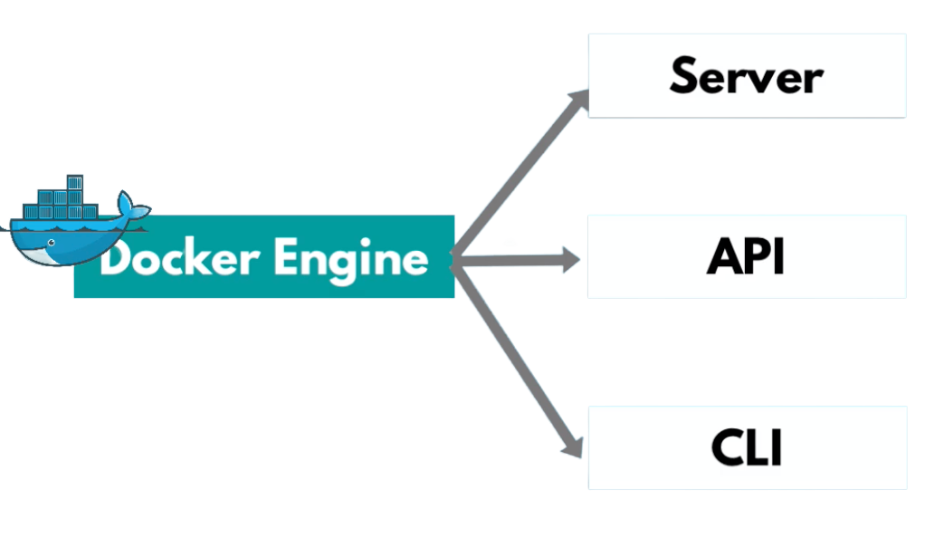
Docker Architecture & its components - 1
Pulling images
Managing images & containers
Interacting with Docker Server
Command Line Interface:
Client to execute Docker commands

Slide 12
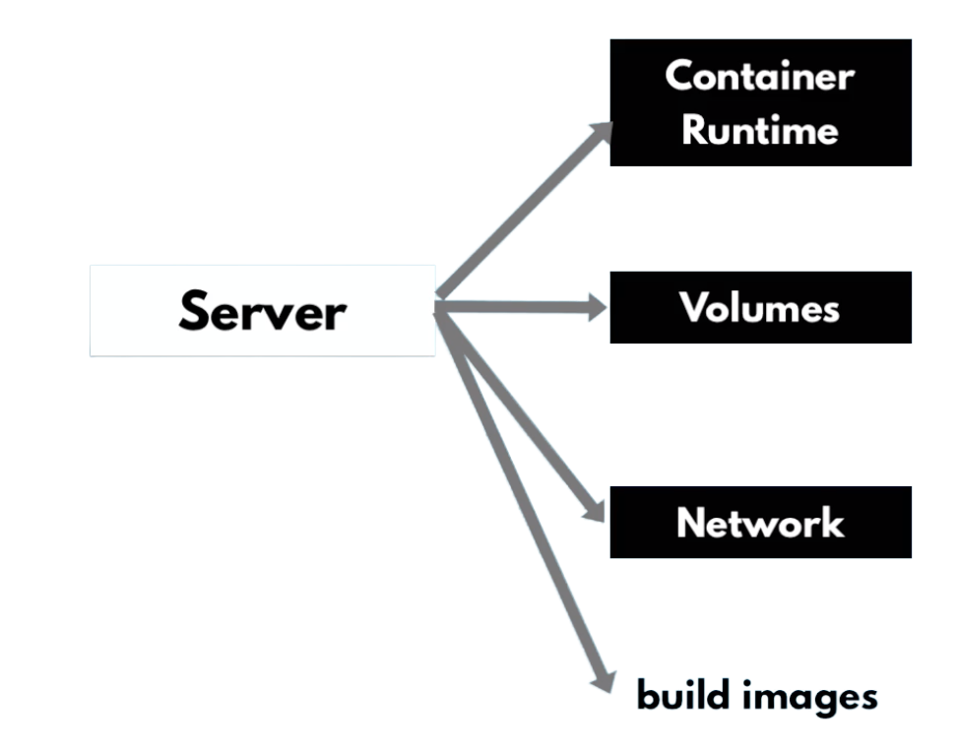
Docker Architecture & its components - 2
Pulling images
Managing container lifecycle
Persisting data
Configuring network for container
communication

Slide 13
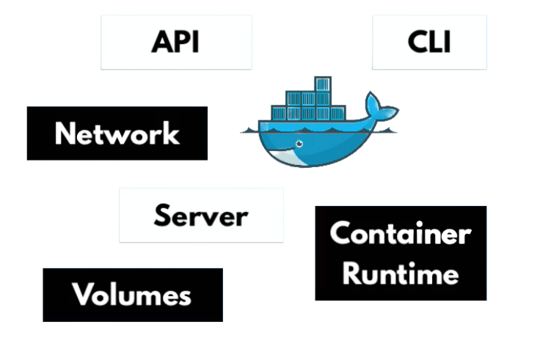

Docker Architecture & its components - 3
Alternatives, if you need only a
container runtime?
Need to build an image?
Docker has many functionalities in 1 application

Slide 14

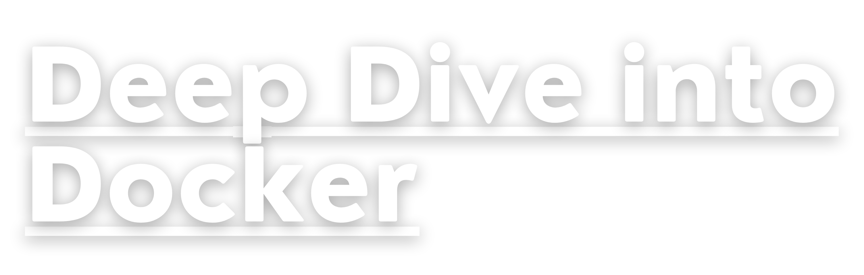

Slide 15


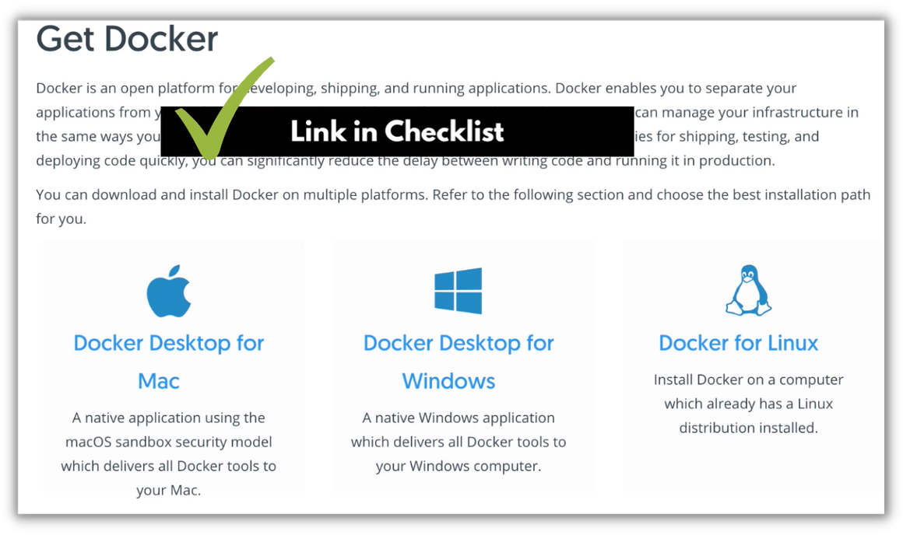
Docker Installation
Linux
Mac + Windows
native support
Docker Desktop

Slide 16
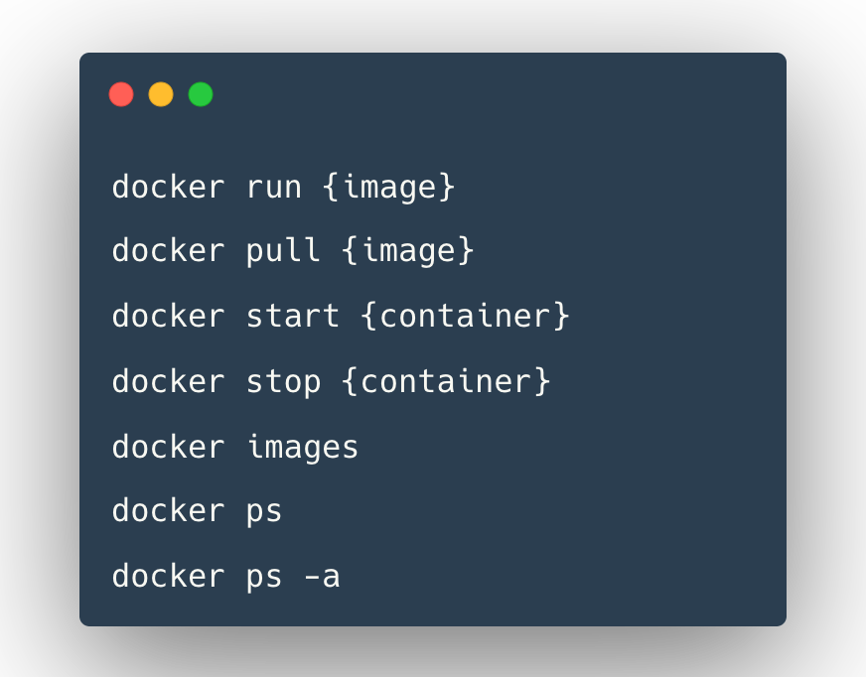
Main Docker Commands
docker run: creates a container from an image
docker pull: pull images from the docker repository
docker start: starts one or more stopped container
docker stop: stops a running container
docker images: lists all the locally stored docker images
docker ps: lists the running containers
docker ps -a: show all the running and exited containers
Debug Commands
docker logs: fetch logs of a container
docker exec -it: creates a new bash session in the container

Slide 17
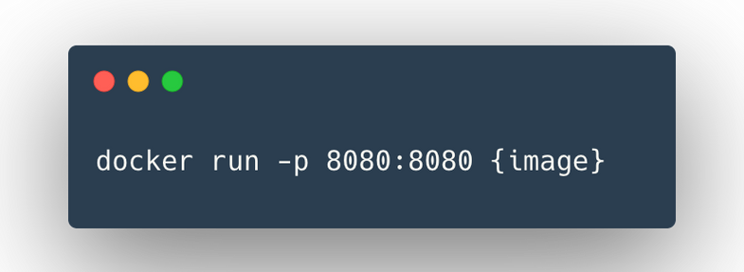
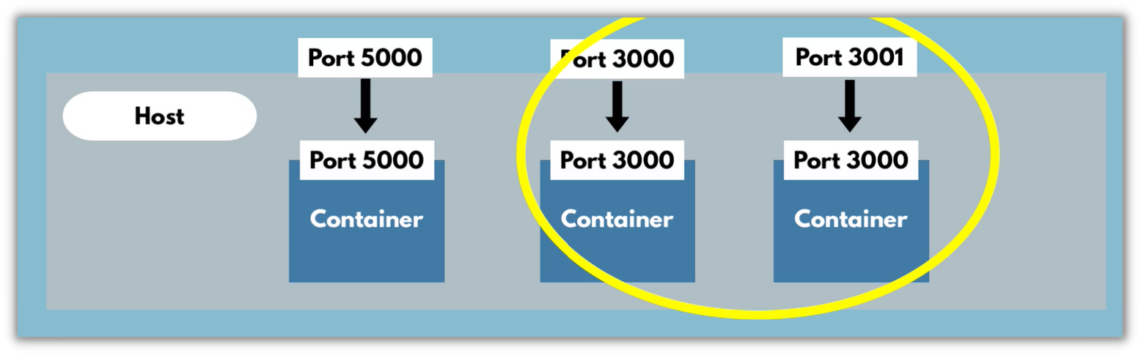
Ports in Docker - 1
Multiple containers can run on your host machine
Port Mapping:
Problem:
But your laptop has only certain ports available Conflict when same port on host machine, so we need to map to a free port on host machine:
host port
container port

Slide 18
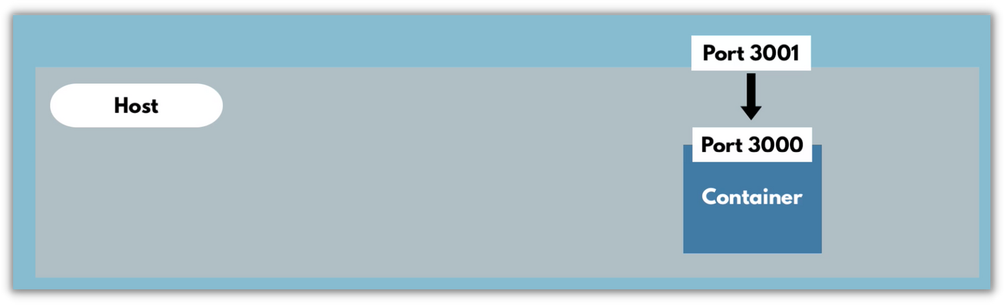
Ports in Docker - 2
Container Port = Port used in container
Host Port = Port on the host machine
some-app://localhost:3001

Slide 19

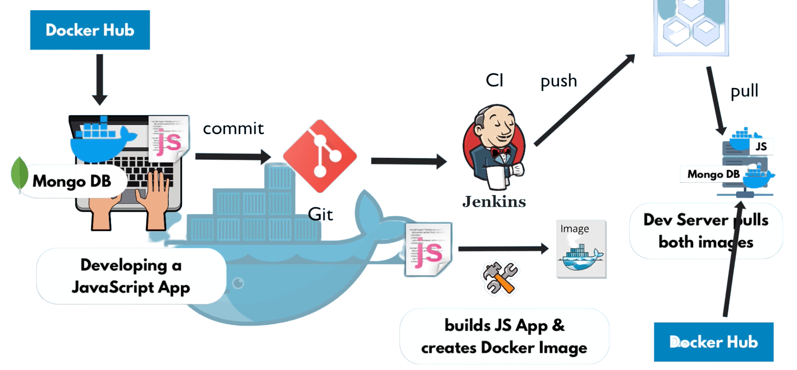
Workflow with Docker
Docker Repository

Slide 20
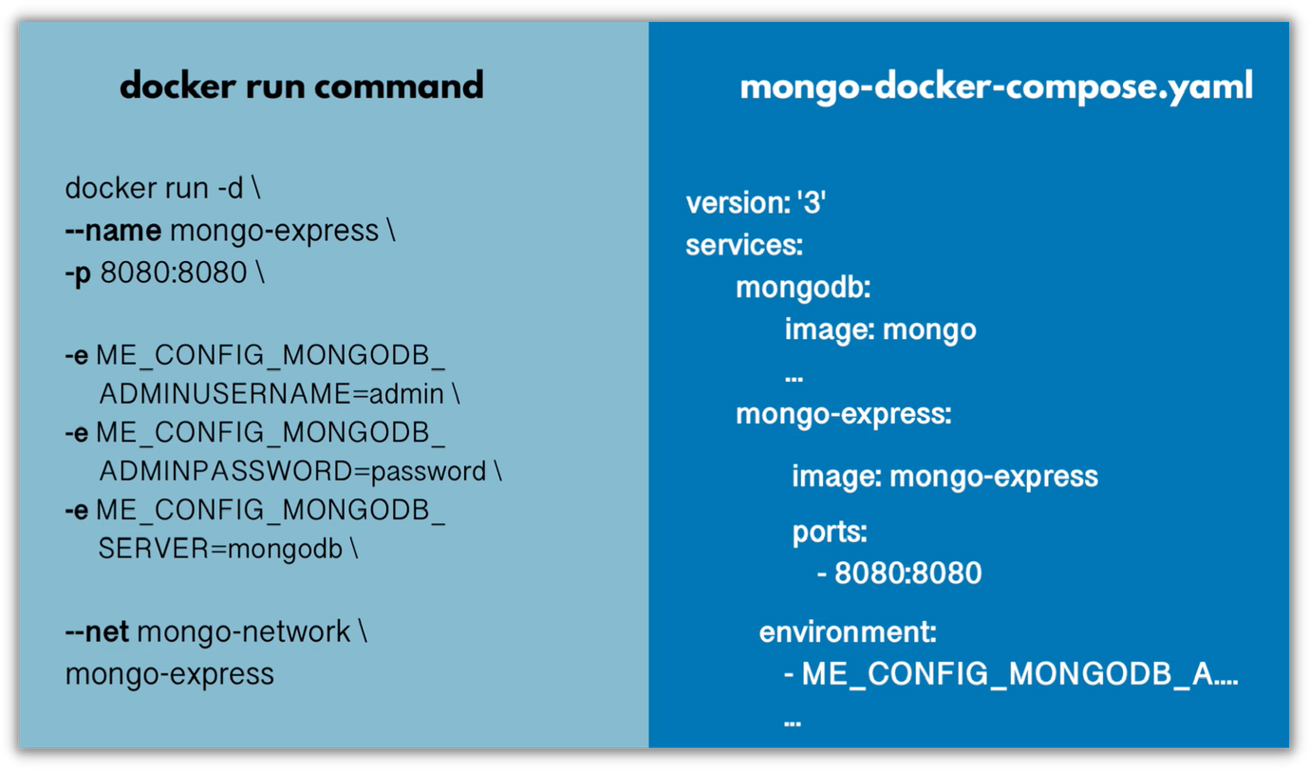
Docker Compose - 1
Docker Compose is a tool for defining and running multiple docker containers
YAML file to configure your application's services:
You can maintain and update configuration more easily than with docker run command
Docker Compose automatically creates a common docker network for docker containers
in it (--net option in docker run)

Slide 21
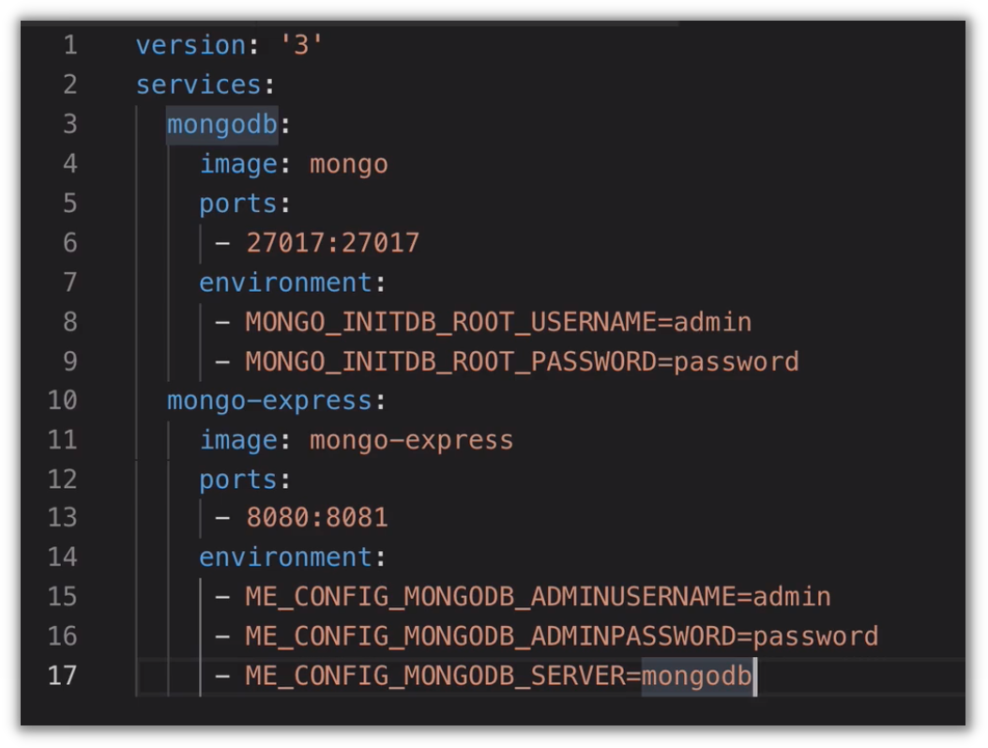
Docker Compose - 2
Example docker-compose.yaml file

Slide 22
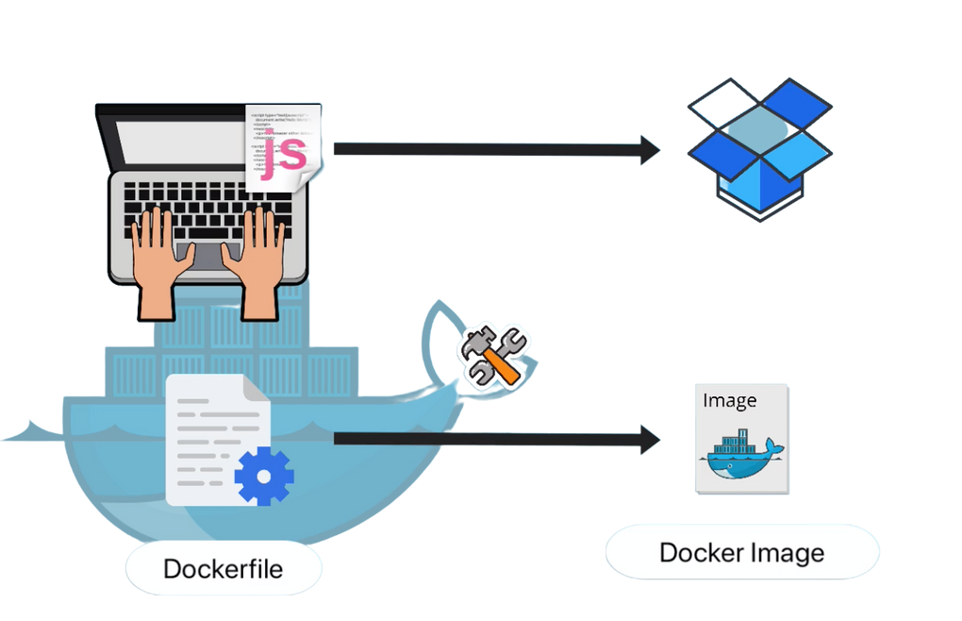
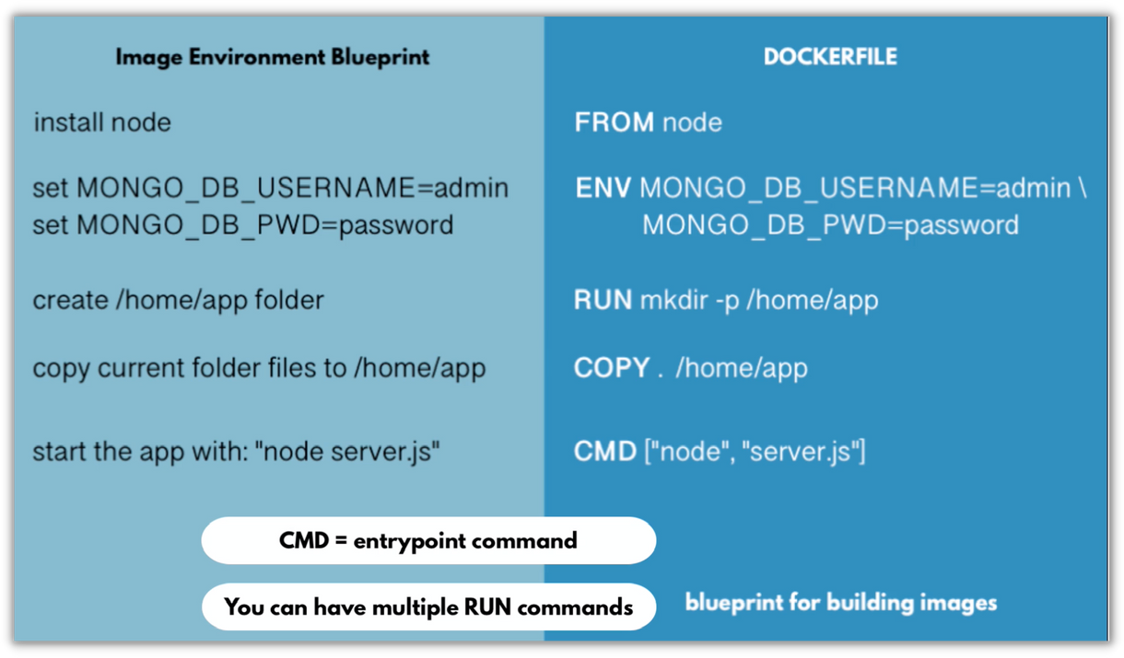
Dockerfile - 1
A simple text file that consists of instructions to build Docker images
Some common Dockerfile commands:

Slide 23
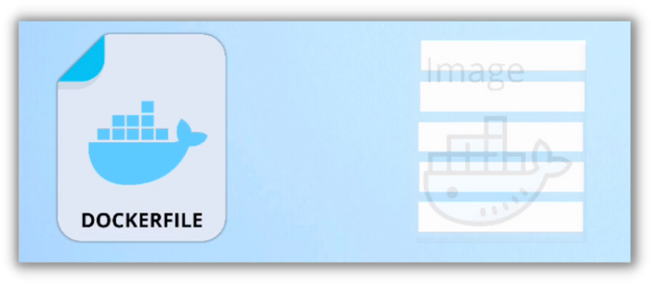
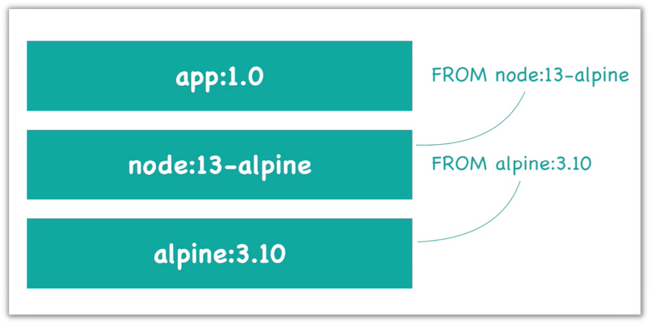
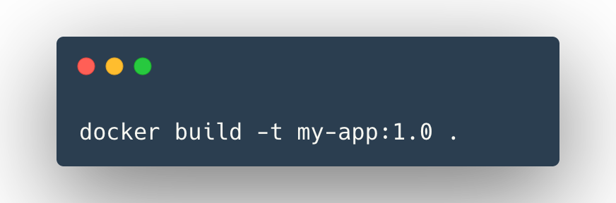
Dockerfile - 2
Each instruction in a Dockerfile
results in an Image Layer:
It's common to start with an existing base image
in your application's Dockerfile:
Command to build an image from a Dockerfile
and a context
The build's context is the set of files at a specified location
Uses the current directory ( . ) as build context

Slide 24
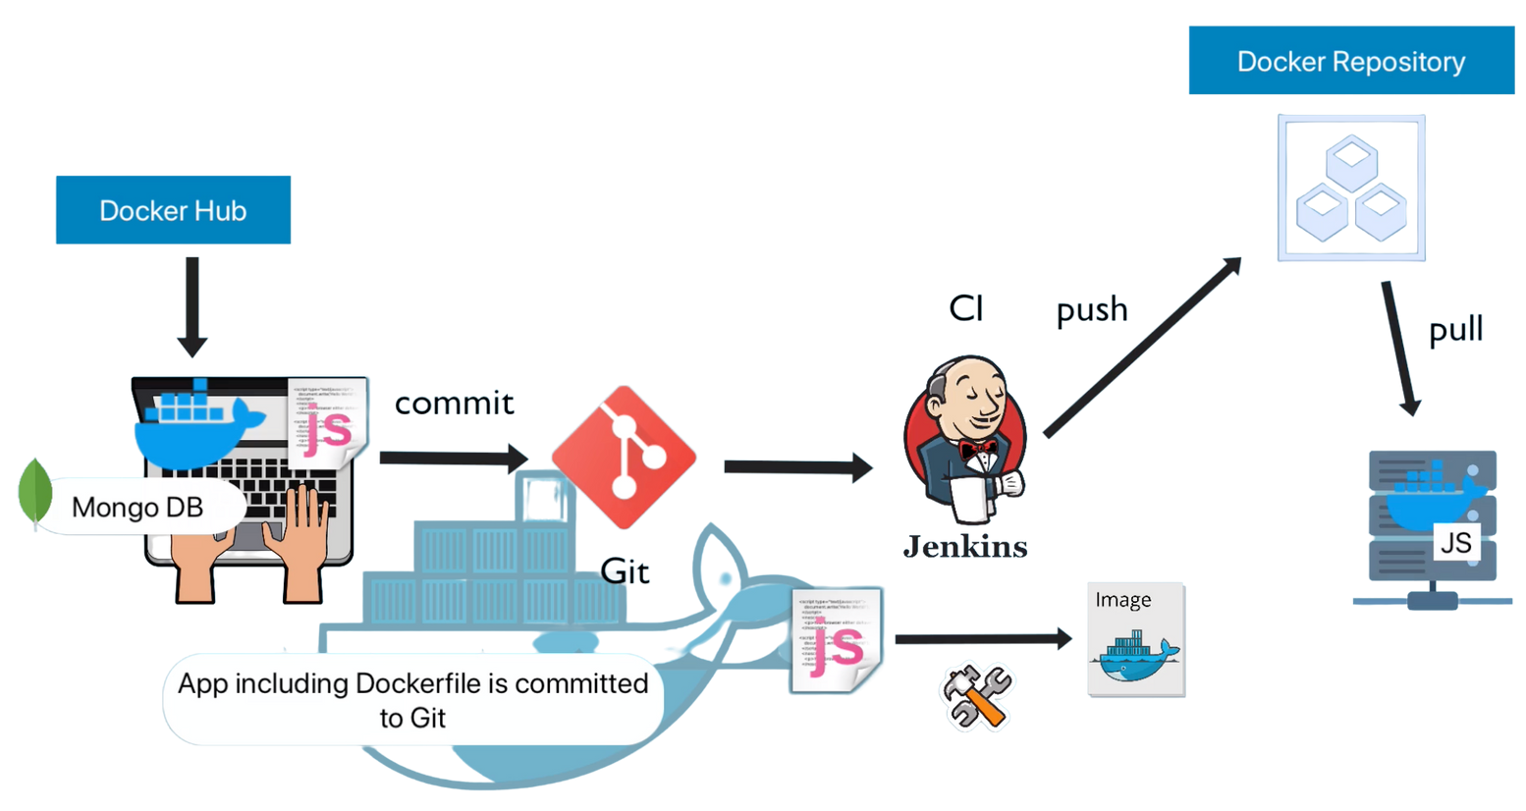
Dockerfile - 3
Dockerfile is used in CI/CD to build the docker image artifact, which will be pushed to Docker repo,
Docker image can then be pull to multiple remote servers or pulled to locally for development and testing etc.

Slide 25

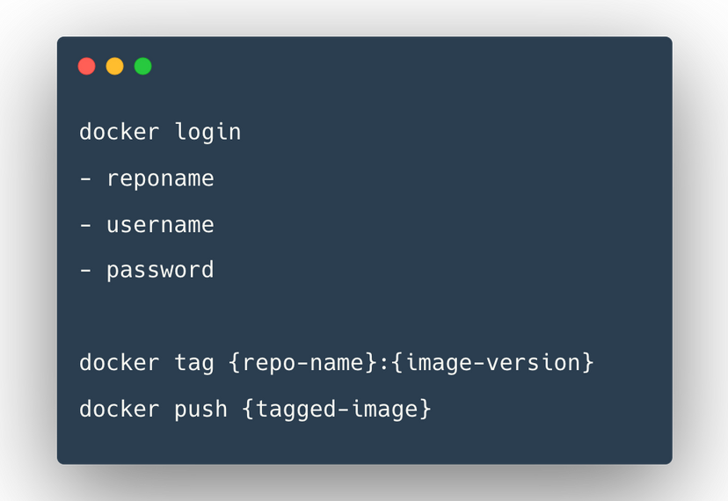
Private Docker Repository - 1
When you work in a company, you will be working with a private docker registry
Public = DockerHub, Example for Private = Amazon Elastic Container Registry "AWS ECR"
Difference to DockerHub
You need to login, so authenticate with the registry before fetching or pushing the image
Tag your image with the registry address and name,
Push the tagged image
registryDomain/imageName:tag

Slide 26
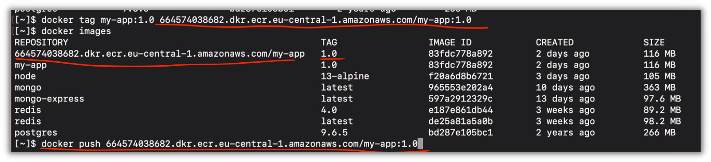
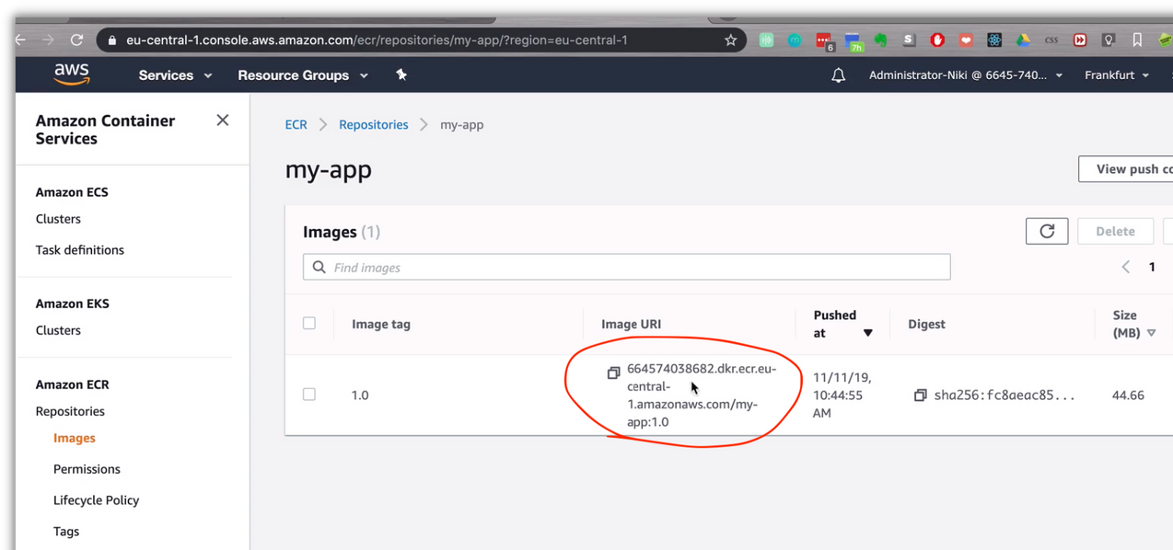
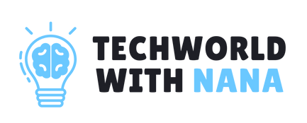
Private Docker Repository - 2
In DockerHub
docker.io is default repository
docker pull mongo:4.2
=
docker pull docker.io/library/mongo:4.2
In AWS ECR or any other private registry
Need to include the registry domain
docker pull 523450290.dkr.ecr.eu-central-1.amazonaws.com/my-app:1.0

Slide 27
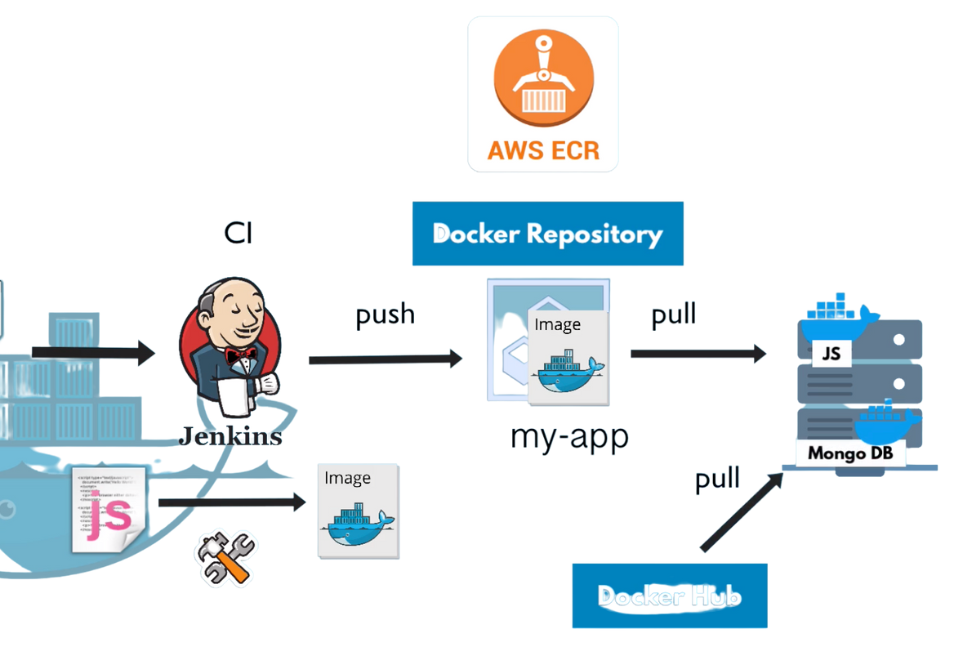
Deploy Docker Containers on a Remote Server
On deployment server, you can pull from both:
Private Images (Your JS application, company internal libraries)
from private docker repository
(AWS ECR)
Public Images (Mysql, MongoDB)
from public docker repository (DockerHub)

Slide 28

Docker Volumes - 1
Volumes are the way to persist data generated by and used by Docker containers
Why Volume are needed for persistence?
Important for
Databases
Other stateful applications
Data is stored on the virtual file system of the container. So
when container is removed, the data is deleted as well.
By default:
Data is gone when removing the container

Slide 29

Docker Volumes - 2
How Docker Volumes work?
Host
Folder in physical host file system is mounted
into the virtual file system of Docker Data gets automatically replicated
Container
/var/lib/mysql/data
Virtual File System inside container
/home/mount/data
Host File System (physical)

Slide 30

Docker Volumes - 3
3 Volume Types
Host Volumes Anonymous Volumes
Named Volumes
Host
Container
/var/lib/mysql/data
/home/mount/data
Host
Container
/var/lib/mysql/data
/var/lib/docker/volumes/ random-hash/_data
Host
Container
/var/lib/mysql/data
/var/lib/docker/volumes/ random-hash/_data
You decide where on the host file system the reference is made
For each container a folder is generated that gets mounted
You can reference the volume by name
Should be used in production
docker run
docker run
docker run
-v /home/mount/data:/var/lib/mysql/data
-v /var/lib/mysql/data
-v name:/var/lib/mysql/data

Slide 31
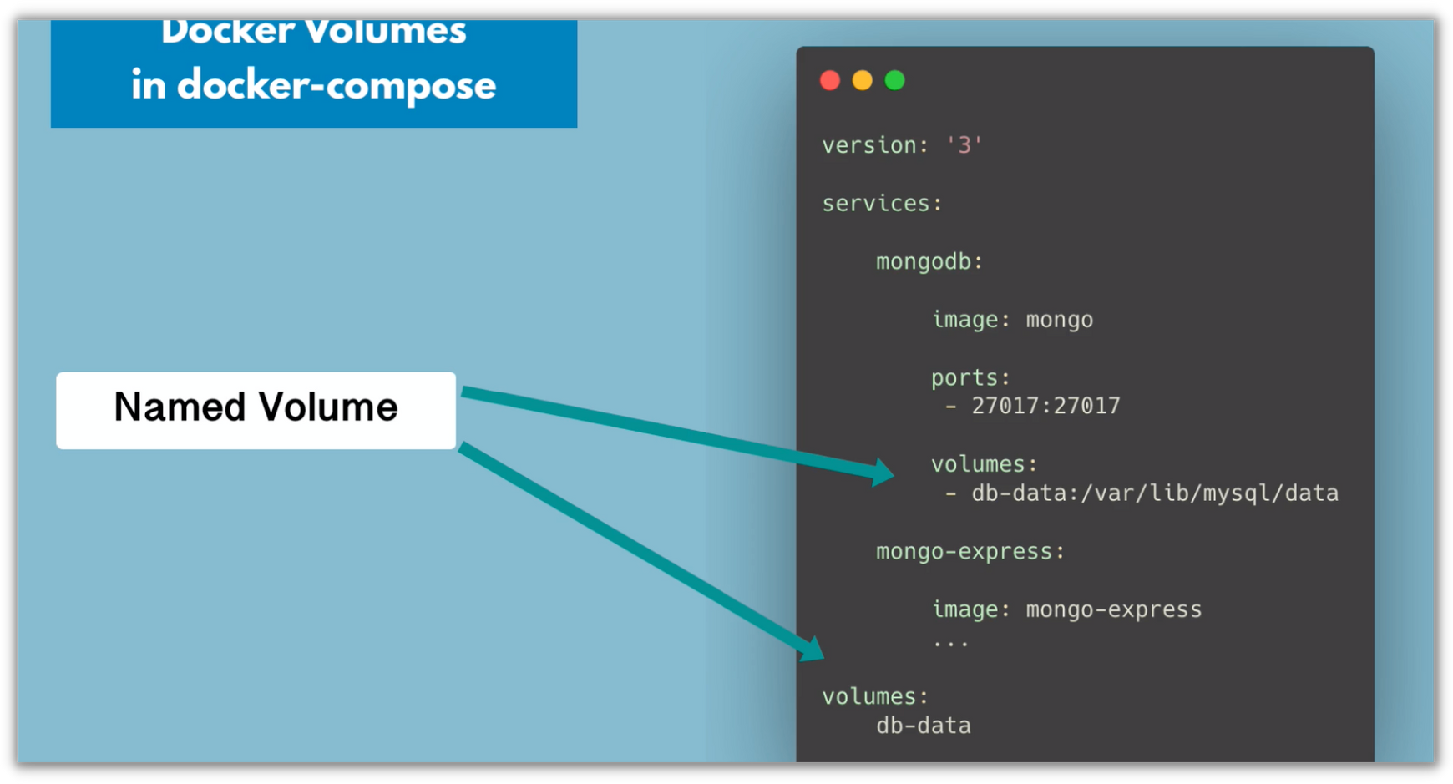

Docker Volumes - 4
Docker Volumes in docker-compose file:
mongo-docker-compose.yaml

Slide 32


Docker Best Practices - 1
Security: Only use official/trusted Docker images as
base image to avoid malware
Security: Use specific image versions
Size & Security: Use minimal base images (e.g. prefer alpine-based images over full-fledged system OS images)
Size: Optimize caching image layers
Size: Use .dockerignore to exclude files and folders
Cleaner Dockerfile: Make use of "Multi-Stage Builds"
Improve Security
Optimize Image Size
Write cleaner and more maintainable Dockerfiles

Slide 33
Docker Best Practices - 2
Security: Use least privileged user (create a dedicated user and group with minimal permissions to run the application)
Security: Scan your images for vulnerabilities Security: Don’t leak sensitive information to Docker images
Improve Security
Optimize Image Size
Write cleaner and more maintainable Dockerfiles

